Slide 1



Slide 2
MongoDB
MongoDB is an open-source, cross-platform document-oriented database application that is freely accessible. As a NoSQL database, MongoDB employs schema-less documents resembling JSON for data representation. It offers a robust framework for storing and retrieving data, providing a flexible and scalable approach to database management.
Established in 2007, MongoDB Inc. introduced an innovative approach to database creation. The term “MongoDB,” derived from “humongous,” was coined to address the challenge of storing vast amounts of data required for scalable use cases.
The exponential growth of digital services and websites necessitated a more adaptable database management system with enhanced functionality.
The quest for swift and information-rich database performance served as the driving force behind the development of MongoDB, with a key design principle centered around the utilization of MongoDB documents for data storage.
Notably, e-commerce and content-serving websites opt for MongoDB due to its scalability and flexibility. As a high-performance database, MongoDB enables businesses to expedite data updates in terms of both structure and content.

Slide 3
SQL
A relational database management system is SQL Server (RDBMS). It is also referred to as Microsoft SQL Server or MSSQL on occasion. Microsoft created SQL Server, which was first made available on April 24, 1989.
On November 4, 2019, SQL Server 2019’s stable release was made available. Programming languages like C and C++ are used to create MSSQL.
Based on E. F. Codd’s relational paradigm, SQL Server was created. Data is kept in tables in RDBMS, and linkages between tables are preserved.
Data is arranged in rows and columns in tables. Each row in the table represents an entry or a record, while each column represents a certain field or feature.
The following editions of Microsoft SQL Server are available, each with a different set of features: Express, Enterprise, Standard, Web, and Developer.
Express edition is freeware for modest and entry-level apps, but other editions, which are licensed-based and utilized for larger projects on commercial levels depending on the service needed, are only available with a paid subscription.
The XML data type format and dynamic management views are supported by SQL Server.

Slide 4


Slide 5
Advantages of SQL
A large volume of data is swiftly and effectively retrieved. Data alteration, deletion, and other operations can be completed almost immediately.
Large numbers of lines of code are not necessary for data retrieval. The use of all fundamental terms like SELECT, INSERT INTO, UPDATE, and others, as well as the simplicity of the syntactical rules, make SQL a user-friendly language.
It offers a consistent platform to all of its consumers around the world because of its documentation and years of long-term establishment.
Irrespective of the platform, this technology can be employed across various software applications on personal computers, servers, and laptops, including operating systems, among others. Furthermore, it offers seamless integration with other programs as per specific requirements and needs.
The system is capable of providing swift responses to intricate inquiries, ensuring quick access to information, and its user-friendly nature facilitates ease of learning and comprehension.

Slide 6
Disadvantages of SQL
Despite SQL’s many advantages, there are some disadvantages as well. The following are some drawbacks of SQL:
When dealing with the database, few people find SQL’s difficult user interface enjoyable.
Some versions of SQL are costly, and hence, programmers cannot use them.
A concealed set of business rules prevents the database from having complete control.
SQL is difficult to scale.
Required specific personnel to manage this technology

Slide 7


Slide 8
Advantages of MongoDB
Professional customer service is offered by MongoDB Inc. to its clients. You can directly contact the MongoDB client support system if there is a problem.
MongoDB is simpler to set up than RDBMS. For inquiries, it also offers a JavaScript client.
A fairly sophisticated functionality for ad hoc queries exists in MongoDB. Because of this, we don’t have to be concerned about upcoming queries.
The fact that MongoDB is a database with horizontal scalability is quite advantageous. You can disperse a huge amount of data among numerous machines while handling it.

Slide 9
Disadvantages of MongoDB
Document nesting at a depth of more than 100 layers is not allowed.
Their document is restricted in size to 16 MB
Each value pair’s key names are stored in MongoDB. Furthermore, data replication is a consequence of joins’ inability to perform. As a result, memory is being utilized more frequently than necessary.
MongoDB does not support joins, just like a relational database. To use the joins functionality, however, the programmer must manually include it.

Slide 10
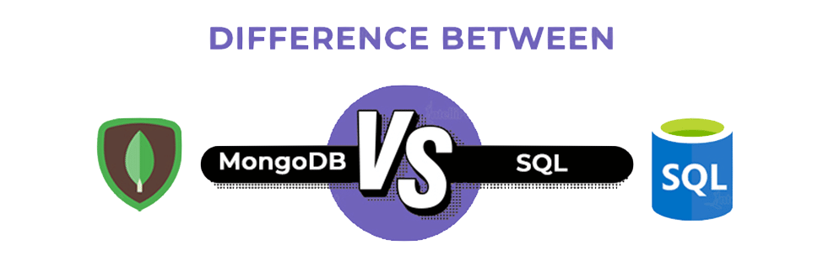

Slide 11
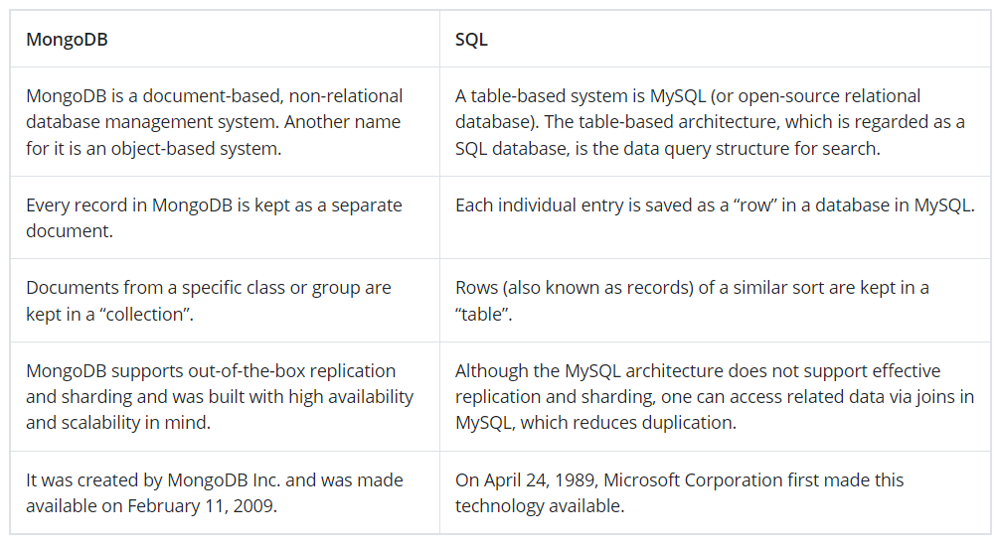

Slide 12
In comparison to the SQL server, MongoDB is faster and more scalable. While the SQL server supports JOIN and Global transactions, MongoDB does not. The MS SQL server does not accommodate large amounts of data, however MongoDB does.
Agile practices are supported by MongoDB, although they are not supported by MS SQL Server.
A SQL database processes SQL queries, whereas MongoDB offers JSON querying. MongoDB is a more dynamic and complicated choice that is appropriate for hierarchical data because of its fundamental properties, as opposed to a SQL Database, which is still more predetermined and appropriate for other types of data storage.Hence this is the reason MongoDB outshines the SQL database.

